Slide 1
Sales Prediction Report
C3T3 – Multiple Regression

Slide 2
Algorithms used
LVM - Gave R2 of 1(one) . Not very reliable since it could cause overfitting of test data.
SVM - # Polynomial gave the best R2 value - 87% - Bad residual plot
# Sigmoid - 74% , Good residual plot but gave negative values in newproducts dataset
# Radial - 50% , Good residual plot *** Predictions were all positive for new products dataset.
# linear - 99% - Not good
Predictions on NewProducts dataset gave negative values
Random Forest – R2 = 90%, Had a great residual plot with values almost lining up at 0.
GBM – Low R2 value 40% and Predictions on New Products gave negative values for volume
As stated, above predictions made by RandomForest model seem to be the most reliable for predicting Volume on NewProducts dataset.

Slide 3
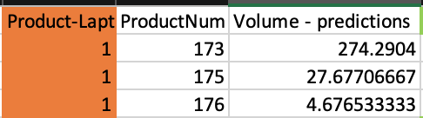
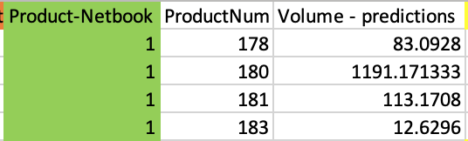
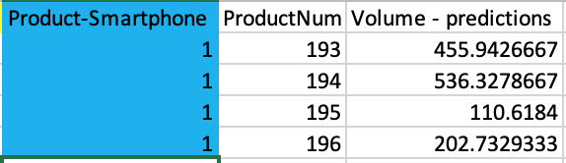
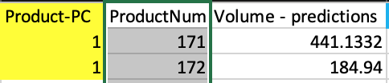
Sales Predictions

Slide 4
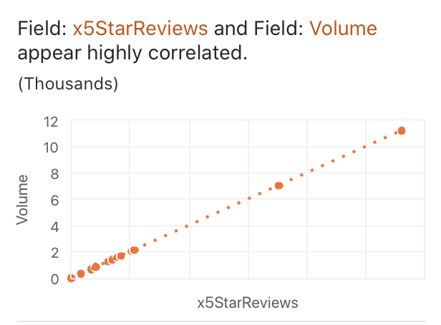
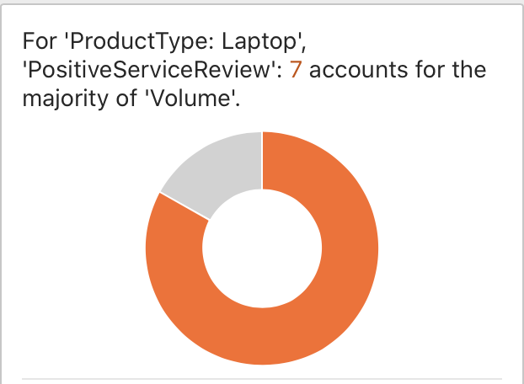
impact of customer and service reviews have on sales volume

Slide 5
Challenges faced when making predictions by re-running model
Model yielded negative predictions which is unreliable

Slide 6
Takeaways for Product Sale prediction
Business Value from this Analysis
Top selling products are Games Console, Accessories, Smartphone, Software, Tablet.
Recommendation
Products with more X5Star Reviews and Positive service reviews sell more
Product Num 180 is predicted to make most sales in volume and also has Better x5Star Reviews and positive service reviews.

